Slide 1

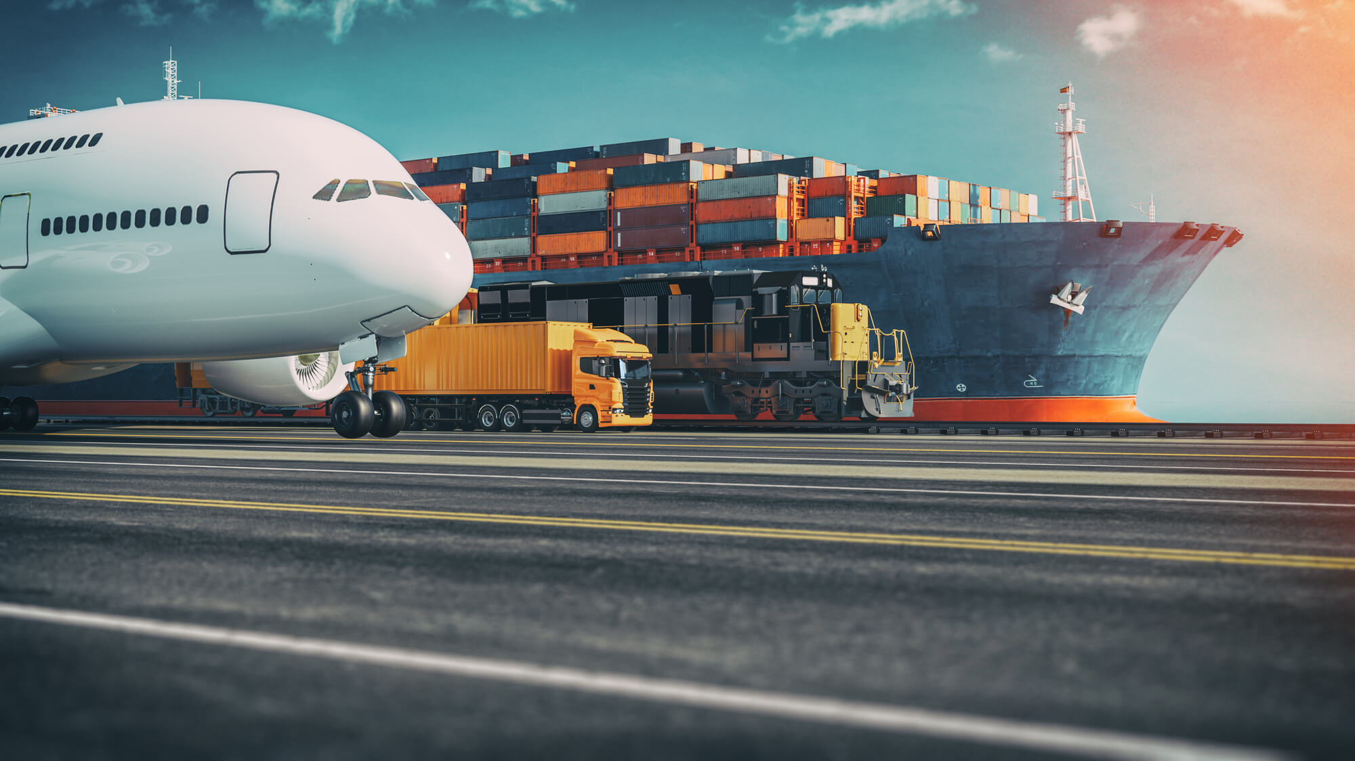
Samsung SDS
Logistics Services
2023.08
Copyright 2023. Samsung SDS Co., Ltd. All rights reserved.
Notes:
안녕하십니까? 삼성SDS 물류사업부에서 글로벌 대외사업을 맡고 있는 우용호 상무입니다.
먼저 이렇게 귀중한 시간을 할애해서 참석해 주셔서 진심으로 감사드립니다
개인적으로 4년 만에 하노이를 다시 방문하는데,
베트남의 역동적인 모습을 현장에서 보게 되니 감회가 새롭고 너무 반갑습니다.
오늘 제가 말씀드릴 주제는 Supply chain에서 digitalization 입니다.

Slide 2



Agenda
I Why SDS
II Cello Square
III 4PL Integrated Logistics
IV Suggestion

Slide 3
I
Why SDS

Slide 4

Why SDS
I.
Logistics Division
Samsung SDS Logistics Division is growing rapidly based on distinctive service offerings and self-developed logistics system Cello System and 4PL integrated logistics.
Non-Samsung Global Revenue*
Non-Samsung SE.Asia Revenue*
Share by Sector
※ As of 2022 (from Global Revenue)
≒1,469 Million U$
≒277 Million U$
18,800
3,549
Hundred Million KRW
Hundred Million KRW
By Business Line
32%
34%
CAGR
CAGR
IT
40%
Logistics
60%
2017
2018
2019
2020
2021
2022
2017
2018
2019
2020
2021
2022

Slide 5
Why SDS
I.
Asia Pacific Region
With the expansion of Samsung Electronics’ production base in Southeast Asia, Samsung SDS has established 8 logistics branches in 7 countries where we continuously expand our local capabilities.
Hanoi
Locations
Coverage
Manila
Bangkok
Ho Chi Minh
Vietnam Hanoi
Vietnam Ho Chi Minh
Singapore Singapore
Thailand Bangkok
Indonesia Jakarta
Malaysia Kuala Lumpur
Philippines Manila
Australia Sydney
4PL Integrated Logistics
Air Export / Import
Sea Export / Import
Customs Clearance
Haulage / Delivery
Warehousing
Last Mile Delivery
Project Logistics
Cold-chain Logistics
Air CSA/GSA
E-Commerce Logistics
CY Depot Management
Kuala Lumpur
Singapore
Jakarta
Sydney
Vietnam JV(ALS SDS)
Vietnam JV(MP Logistics)
Thailand JV(SDS Acutech)
RHQ
8 Branch
3 JV(Joint Venture)

Slide 6







Why SDS
I.
SDS Hanoi Branch
Growing rapidly as one of top logistics entity in Vietnam since its establishment in 2011.
70K Ton
Air Cargo
1 main office
1 sales office
Manpower
Revenue
Yen Phong KCN, Bac Ninh
PVI Tower(14F), Hanoi
Logistics Experts
In 2022
380
1.45 Trillion KRW
6 sites
01 Airport Off-Terminal
W/H Area (9,830m²)
35 mins from Airport
120 mins from Seaport
Off terminal for SEC
04 CE Warehouse
W/H Area (13,000m²)
40 mins from Airport
95 mins from Seaport
Warehouse for SEC CE product
15K TEU
Ocean Cargo
Key Customers
02 Cold-chain DC1
W/H Area (9,700m²)
40 mins from Airport
95 mins from Seaport
Cold-chain for WCM
05 MX Warehouse
W/H Area (2,145m²)
40 mins from Airport
95 mins from Seaport
Warehouse for SEC MX product
58K Ton
Truckloads
Revenue
03 Cold-chain DC2
W/H Area (4,500m²)
35 mins from Airport
120 mins from Seaport
Cold-chain for Welstory
06 SVC Warehouse
W/H Area (5,000m²)
40 mins from Airport
95 mins from Seaport
Warehouse for SEC service parts
44K m²
Warehouse

Slide 7











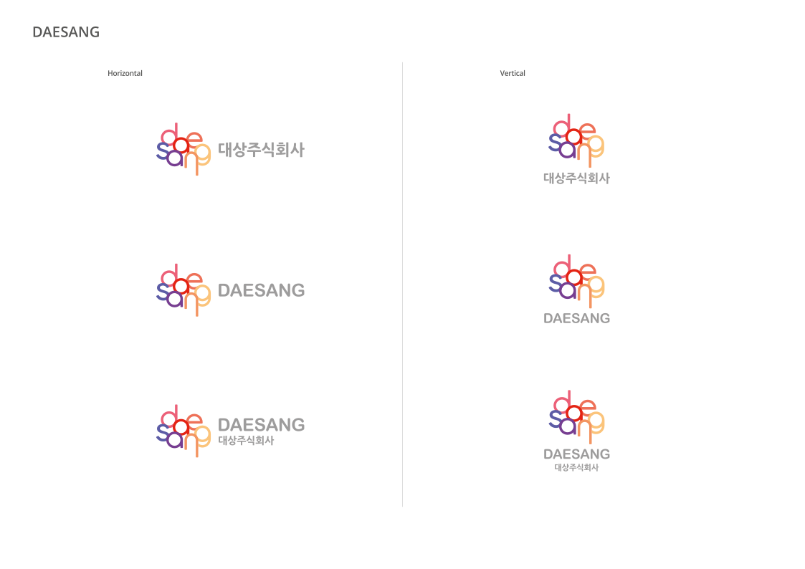


Why SDS
I.
Key Customers in Asia Pacific
Continuously creating best practices for major brands in AP region by enhancing customer satisfaction.
#1 convenience store network in Vietnam
#2 semiconductor
manufacturer in Vietnam
#1 home appliances factory/exporter in Vietnam
#1 household goods factory/retailer in Vietnam
#1 ev automobile manufacturer in Vietnam
#1 home appliance rental in Malaysia
#1 copper foil manufacturer in Malaysia
#6 solar panel manufacturer in the World
#1 industrial manufacturer in Singapore
#3 recycling paper manufacturer in Thailand
and many more in Southeast Asia…
#7 tire manufacturer in the World
#1 memory mattress supplier in Australia
#1 oil & gas provider in the Singapore

Slide 8

Why SDS
I.
Supply Chain Risk
Innovation in logistics management has been lacking compared to the development of ERP system over the last 30 years. Risk and the needs for innovation is amplifying even more in post-Covid era.
Logistics
Quality
Sales
Post-Covid Risk Increase Factors
Stock & Aging increase
Pressure on logistics cost saving
Frequent changes in carriers’ schedule
Increase of e-Commerce small orders
Production
Purchase
Customer
Experience
“Logistics not only affects costs but also overall management efficiency including sales, purchase, quality, production and customer experience.”

Slide 9
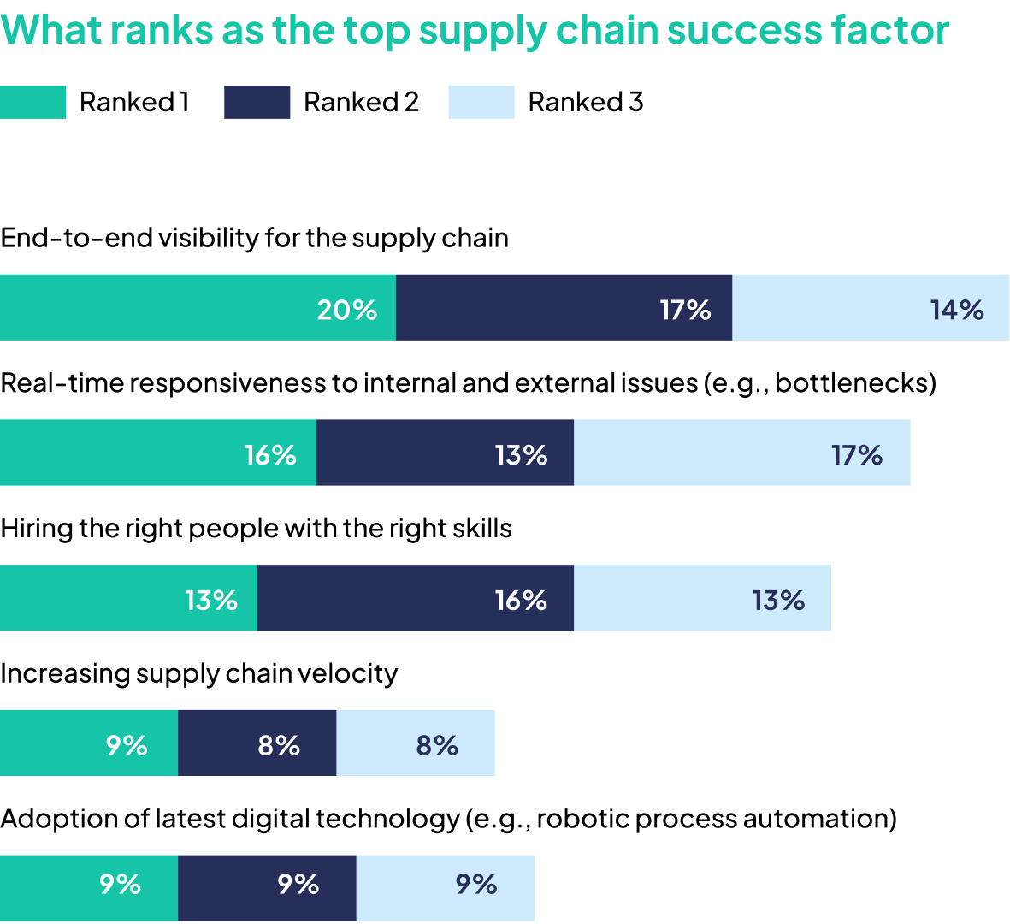
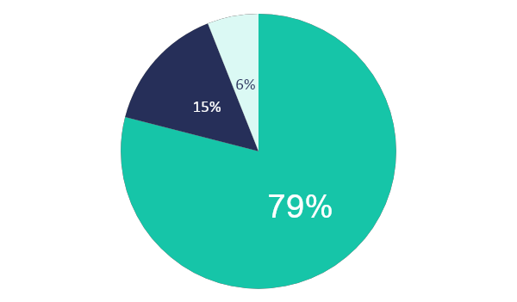
Why SDS
I.
Key Success Factor of Logistics Innovation
For building a successful supply chain, ‘End-to-end visibility’ is considered one of the most important factor, but surprisingly many shippers do not have it.
What ranks as the top supply chain success factor?
Do you have visibility of your supply chain?
Full visibility
Limited to
Production
Partial visibility

Slide 10
Why SDS
I.
Benefits of Logistics Innovation
Digitalizing the supply chain can substantially improve business. McKinsey suggests, can reduce sales lost risk by 65-70% and inventories by 35-75%.
Standard
performance
Functional
excellence
Digital supply chain+
functional excellence
Lost sales
and service
50%
65-70%
Service
10-15%
15-30%
Transport and
warehousing
Agility
Cost
5-10%
Administrative
50-80%
Capital
20-50%
35-75%
Inventories
Source : Digital transformation: Raising supply-chain performance to new levels, McKinsey Analysis in 2021.

Slide 11
Why SDS
I.
SDS Logistics Innovation Strategy
Besides facilitating competitive logistics cost structure, 4PL integrated logistics also streamline logistics process and integrate data to impact business in various area like sales, production, purchase, etc.
4PL Integrated Logistics
Logistics innovation is able to impact various areas of business comprehensively
Standardization
Integration
Sales
Operation
Promotion Plan
Pre-PO(Sales Maximization)
RTF to Customer
Delivery Commitment
Production Scheduling
Inventory Planning (On-hand + In-transit)
Lead-time Reduction
Process Optimization
System Implementation
Efficiency Measurement
Others
Logistics
Revenue/Cost Forecast
Lead-time Management
Quality Management
Customer Satisfaction
Network/Route Optimization
Inventory Management
Pre-alert
Logistics Cost

Slide 12

Why SDS
I.
Samsung SDS’ Solution for Digitalization
SDS provides Cello Square for international transportation and 4PL integrated logistics solution for warehousing and delivery service.
Freight
Forwarding
Streamline your freight management through our platform and eliminate the inefficiencies of the old ways.
Contract Logistics
Innovate the whole supply chain through standardization, system implementation, measurement and supply chain optimization to directly impact sales, product quality, customer satisfaction, etc.
4PL Integrated
Logistics

Slide 13
Why SDS
I.
Cello System
Possess in-house logistics system that can be customized in accordance with customers’ needs
(Supply Chain without system will soon face limits)
Business
Customer
Sales
Logistics
Vendor
Vendor
Logistics
Departure
Hub
Inbound
Logistics
Material
W/H
Factory
Yard
Outbound
Logistics
Sales
W/H
Order
Desk
Buyer
LMD¹⁾
End
Customer
Reverse
Logistics
Cello Offerings
Supply Chain
Planning
Freight Forwarding
Contract Logistics
e-Commerce
Logistics
Specialized
Logistics
Premium
Logistics
Supply Planning
Air Transport
Inbound Logistics
Service Material
Logistics
Express
Consulting
Video Analytics
Inventory Inspection
Sales Demand
Forecast
Ocean Transport
Factory Logistics
Project Cargo/
Heavy Cargo
Container Yard Mgmt.
Intermodal
Fulfillment
Supply Chain
Traceability
Outbound Logistics
Smart Warehousing
Promotion Planning
Freight Consolidation
Warehousing
Customs Clearance
Contactless Delivery
Supply Chain
Efficiency
Last Mile Delivery
Fulfillment Center
Customs Clearance
CSA (Cargo Sales Agent)
Reverse Logistics
Analysis of
Workers’ Travelling
Reverse Logistics
Cluster Hub
Risk Mgmt.
Big Data & IoT & Blockchain & VR/AR & AI

Slide 14
II
Cello Square

Slide 15
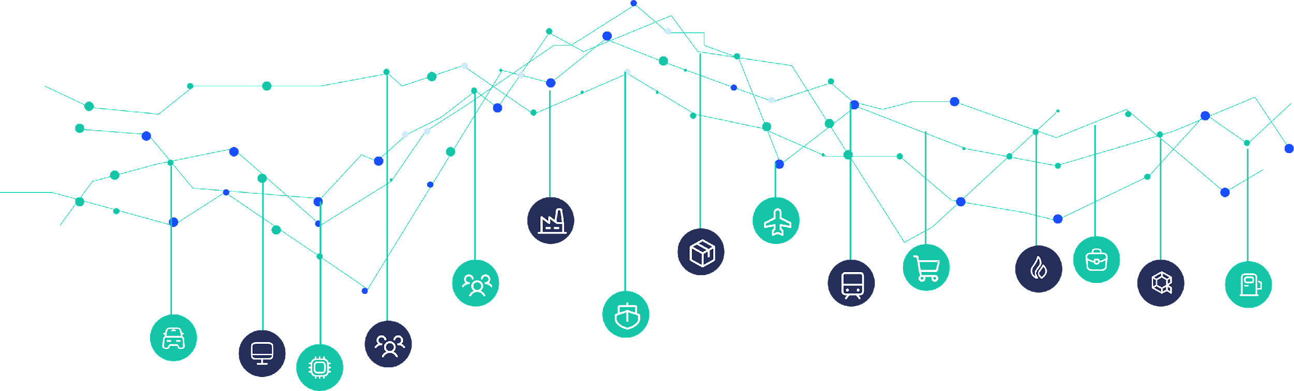

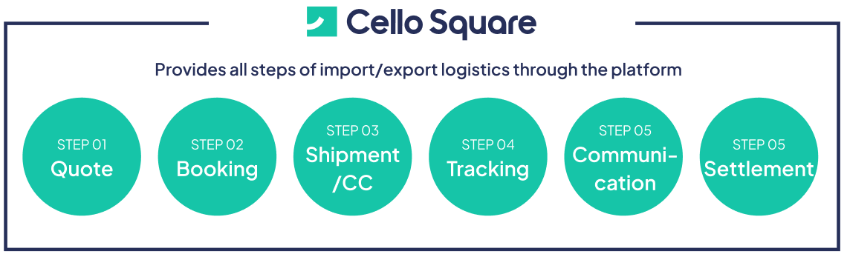
Cello Square
II.
Steps of complex tasks are simplified and managed on one platform from quotation inquiry and booking to shipping document management, shipment tracking and settlement.

Slide 16
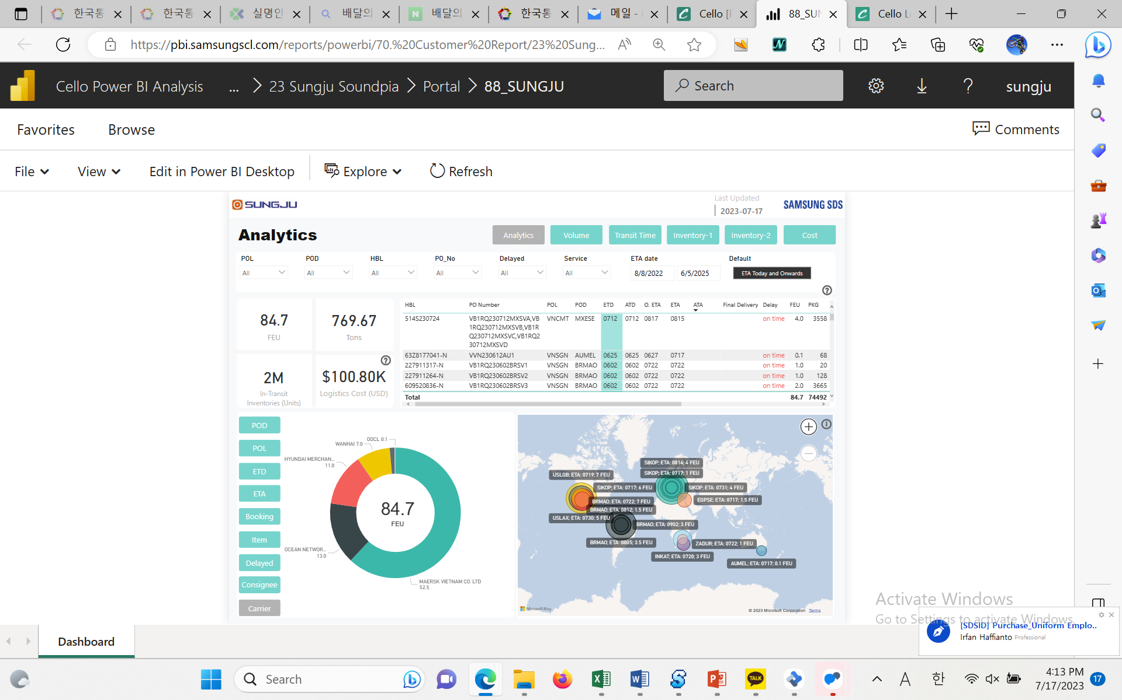
Cello Square
II.
Impact ① Logistics Operation Communication Innovation
Typical inefficiencies in global operation like communication limitations due to time lag and dependency on phone/e-mail/excel can be eliminated. (Customizable analytics)
Logistics Status Dashboard
Communication Innovation related to Shipment Schedule
Do not require manual phone/e-Mail/Excel works
Integrated Management of Shipping Documents
Removes dispersed shipping document management and eliminates confusion arising from e-Mail/Excel work
Check Logistics Operation Status from various perspectives
Customizable analysis tools(ex: delay status) enables quick identification of risks and assist decision-making

Slide 17
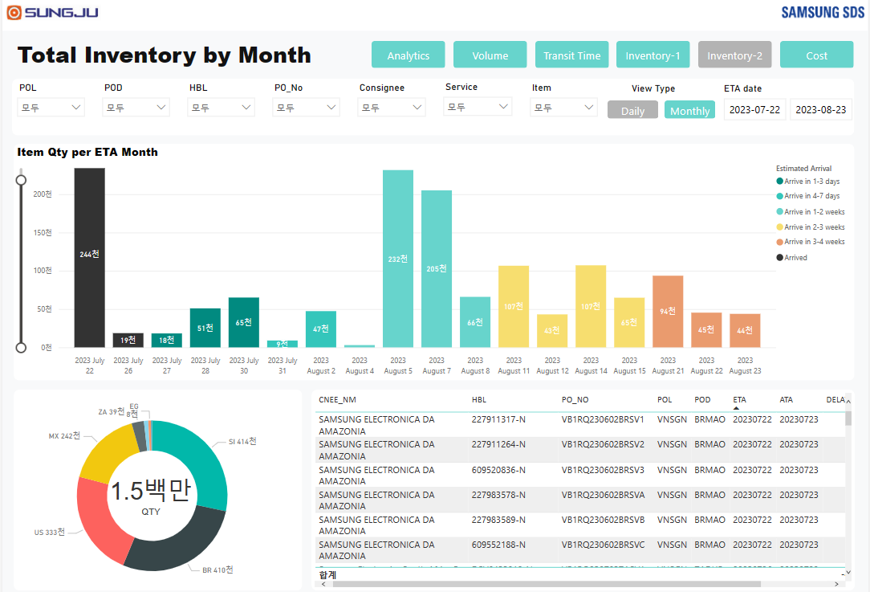
Cello Square
II.
Impact ② Minimize Sales loss, Production setbacks, Logistics costs based on In-transit Inventory Info
Possible to determine the available inventory by identifying the quantity of the intransit inventory by arrival date, which also supports RTF for sales and feedstock outlook.
In-transit Inventory Qty Information
(Example) Analysis of Available Stock in the near future
*On-hands + Intransit Inventory = Available stock
Available Stock
Inventory by ETA date
On-hands
Intransit Inventory
7/22
8/4
Possible to apply
alternative routes
8/23
Additional sales possible
before 4 August
※ Analyze and apply alternative routes which lead time is long with lower rate if there is sufficient inventory available.

Slide 18
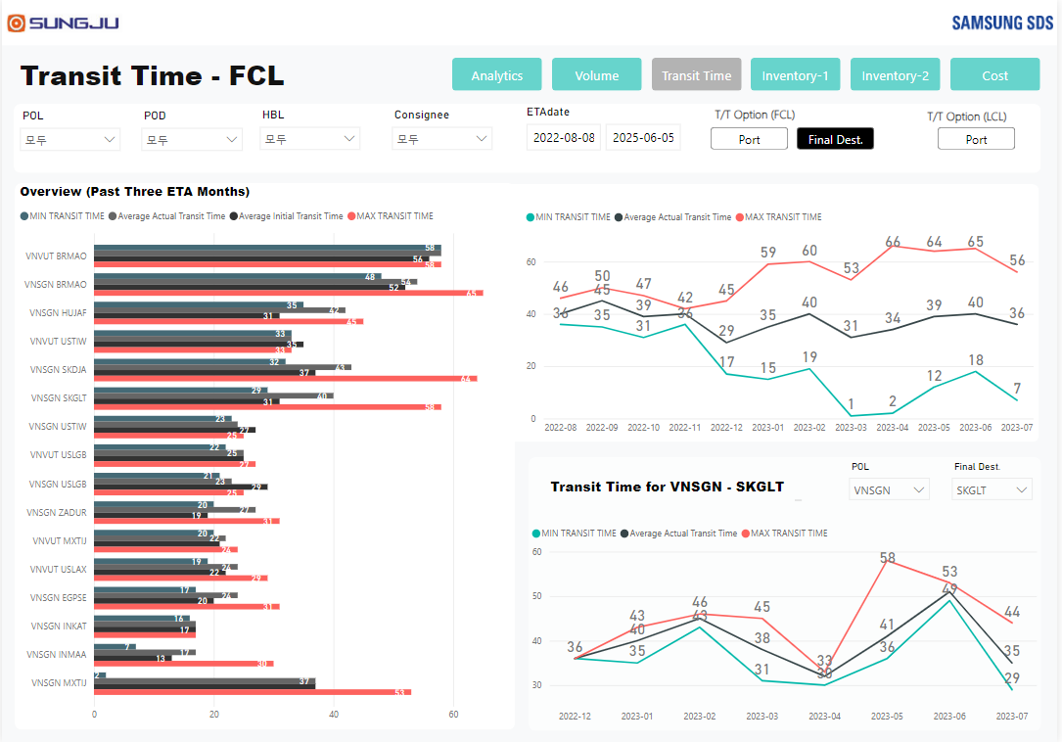
Cello Square
II.
Impact ③ Stock Optimization with Replenishment Cycle Elaboration
You can elaborate Replenishment Cycle when you minimize the impact of frequent schedule changes on the supply chain and accurately understand transit time changes.
Transit Time by Routes
Accumulated Transit Time by Route data and analysis
3-month transit time data by route analysis (Min, Max, Average)
→ Find irregularities in routes and improve
(Customizable: transit time by carrier, etc.)
Final Destination Arrival Information
Optional selection : lead time check and analysis on delivery to final destination
Monthly Transit Time Analysis of specific Route
You can select specific route and analyze detailed Transit Time data
→ Assists decision-making on replenishment cycle
(Avoiding decision based on PIC’s guess)

Slide 19
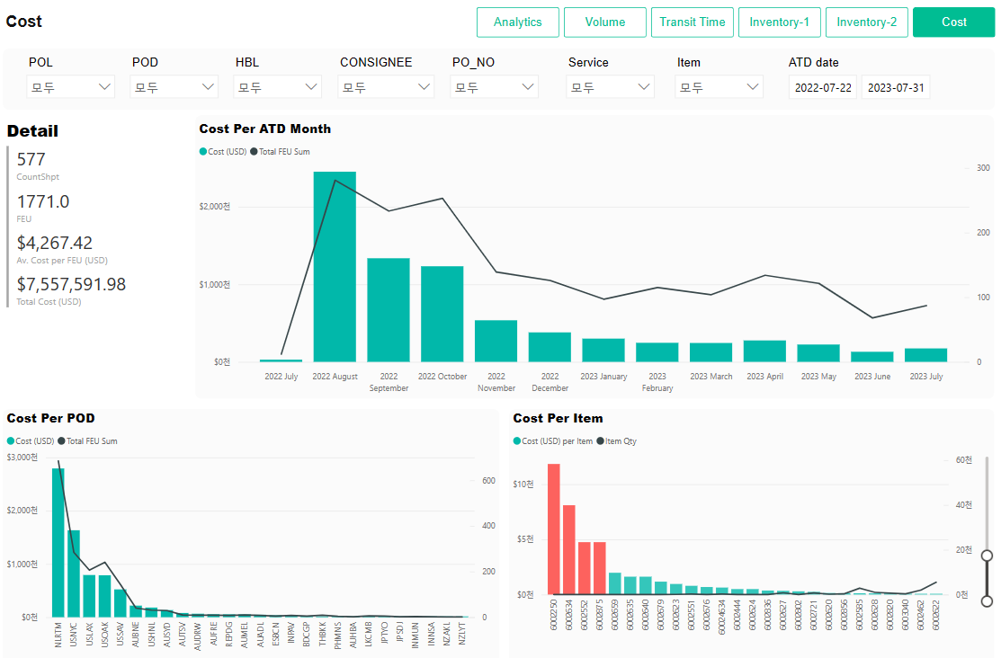
Cello Square
II.
Impact ④ Logistics Cost Optimization based on Cost Analysis by Type
Risk management with accurate tracking, intransit inventory management and applying alternative routes are optimization factors that maximizes the cost reduction impact.
Cost by Month/Destination/Item
1
Monthly Volume and Logistics Cost Analysis
Volume and logistics cost trend analysis by period
→ Overview on logistics cost trend supports various
decisions like sales planning, etc.
Comparison and Analysis by Routes
Analysis data can be used to establish production planning and export strategy
Logistics Cost Analysis by Product/Item
Logistics cost comparison between products
→ Logistics cost reduction impact by product/geo mix
optimizing (maximize profitability)
1
2
2
3
3

Slide 20
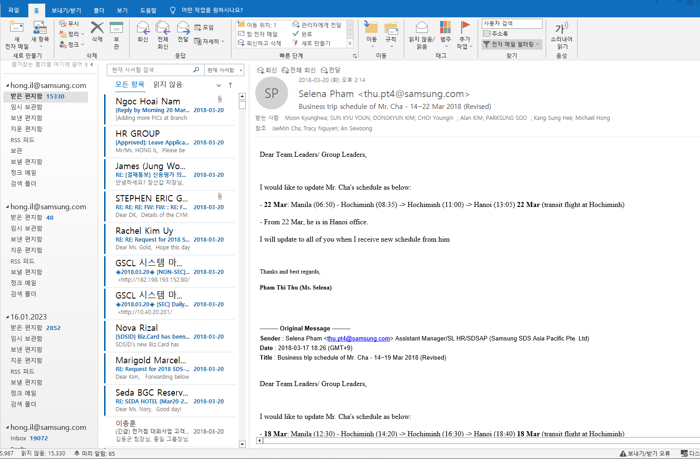
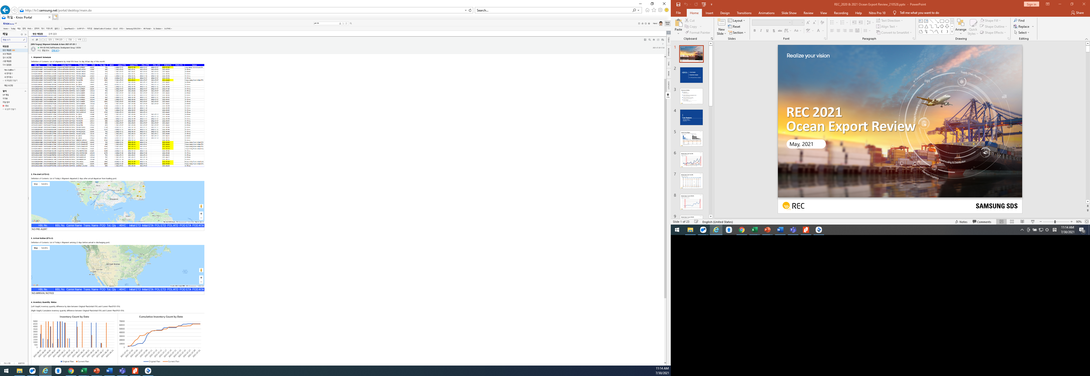
Cello Square
II.
Impact ⑤ Maximize Work Convenience with Automatic e-Mail setting
Customized reports are sent via automatic e-mail notification to provide key information to customers without logging into the system.
Automatic e-Mail Report
1
ETA Schedule List of all Shipments of this month
Departure/arrival time and delay info by shipment
→ System based automatic e-mail report
(Possible to adjust send-out frequency)
Pre-Alert Function
Vessel location check after departure (Visual confirmation)
→ Sent 2 days in advance of ETA [Shipping Doc attached]
Intransit Inventory Information
Intransit inventory by ETA
Risk sensing in advance by comparing inventory quantity with sales plan
→ Back-up data for replenishment/order planning
Customizable
2
3

Slide 21
III
4PL Integrated Logistics

Slide 22
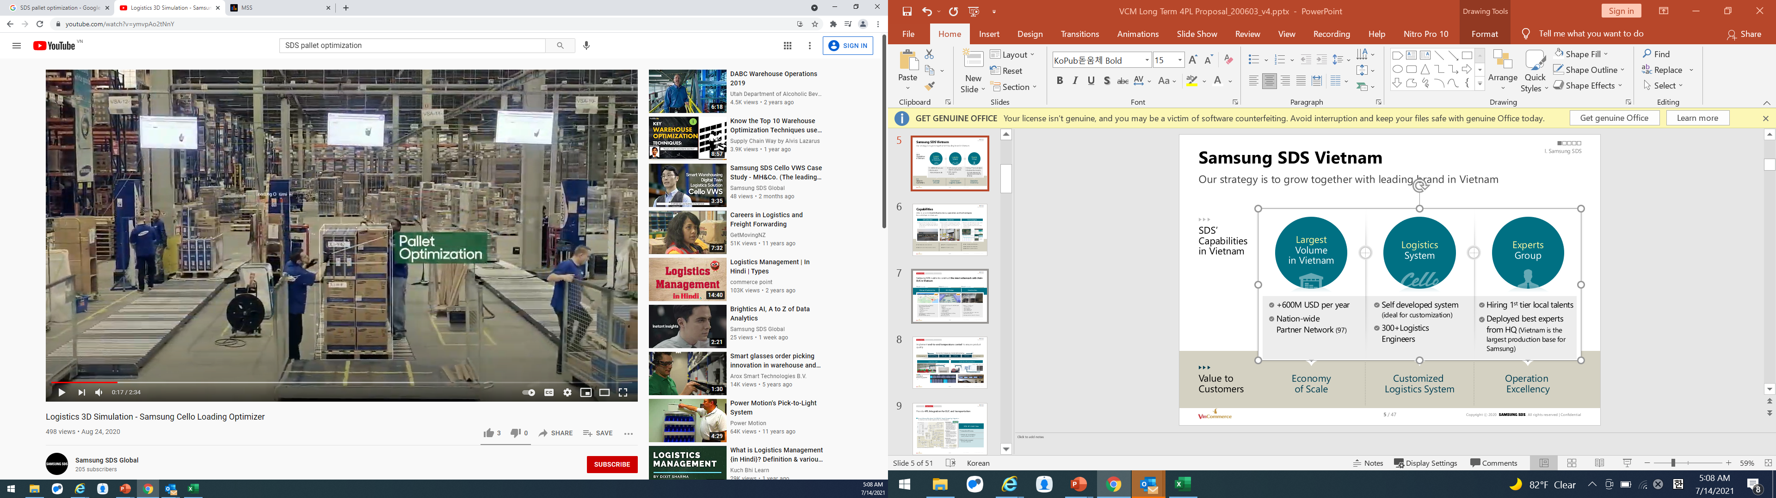
4PL Integrated Logistics
III.
4PL Integrated Logistics
Provide innovations in supply chain through 4PL integrated logistics.
(Logistics innovation aims improvement in sales, purchase, production, quality and customer experience)
Operation
Trans- portation
Production
Distribution
Retail
Consumer
System
Integrated Modules (WMS, TMS, FIS, etc)
In-house developed (easy to customize)
Process
Innovation
Standardization
Integration
Optimization
Impact
To Customers
Logistics operation efficiency
Sales, Procurement, Forecast, Planning, Customer Service, etc

Slide 23
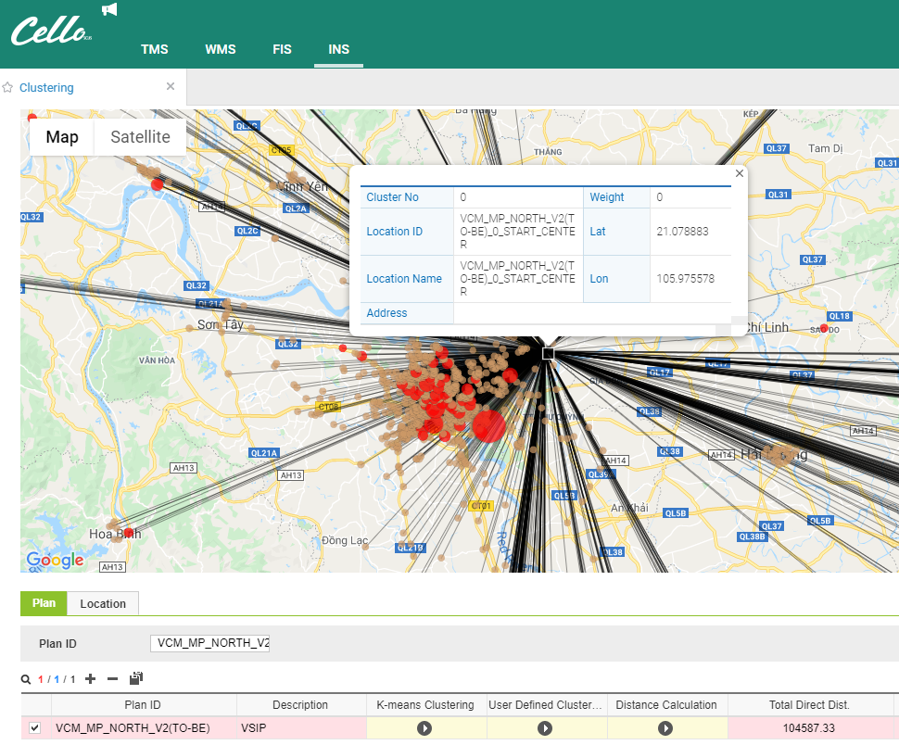
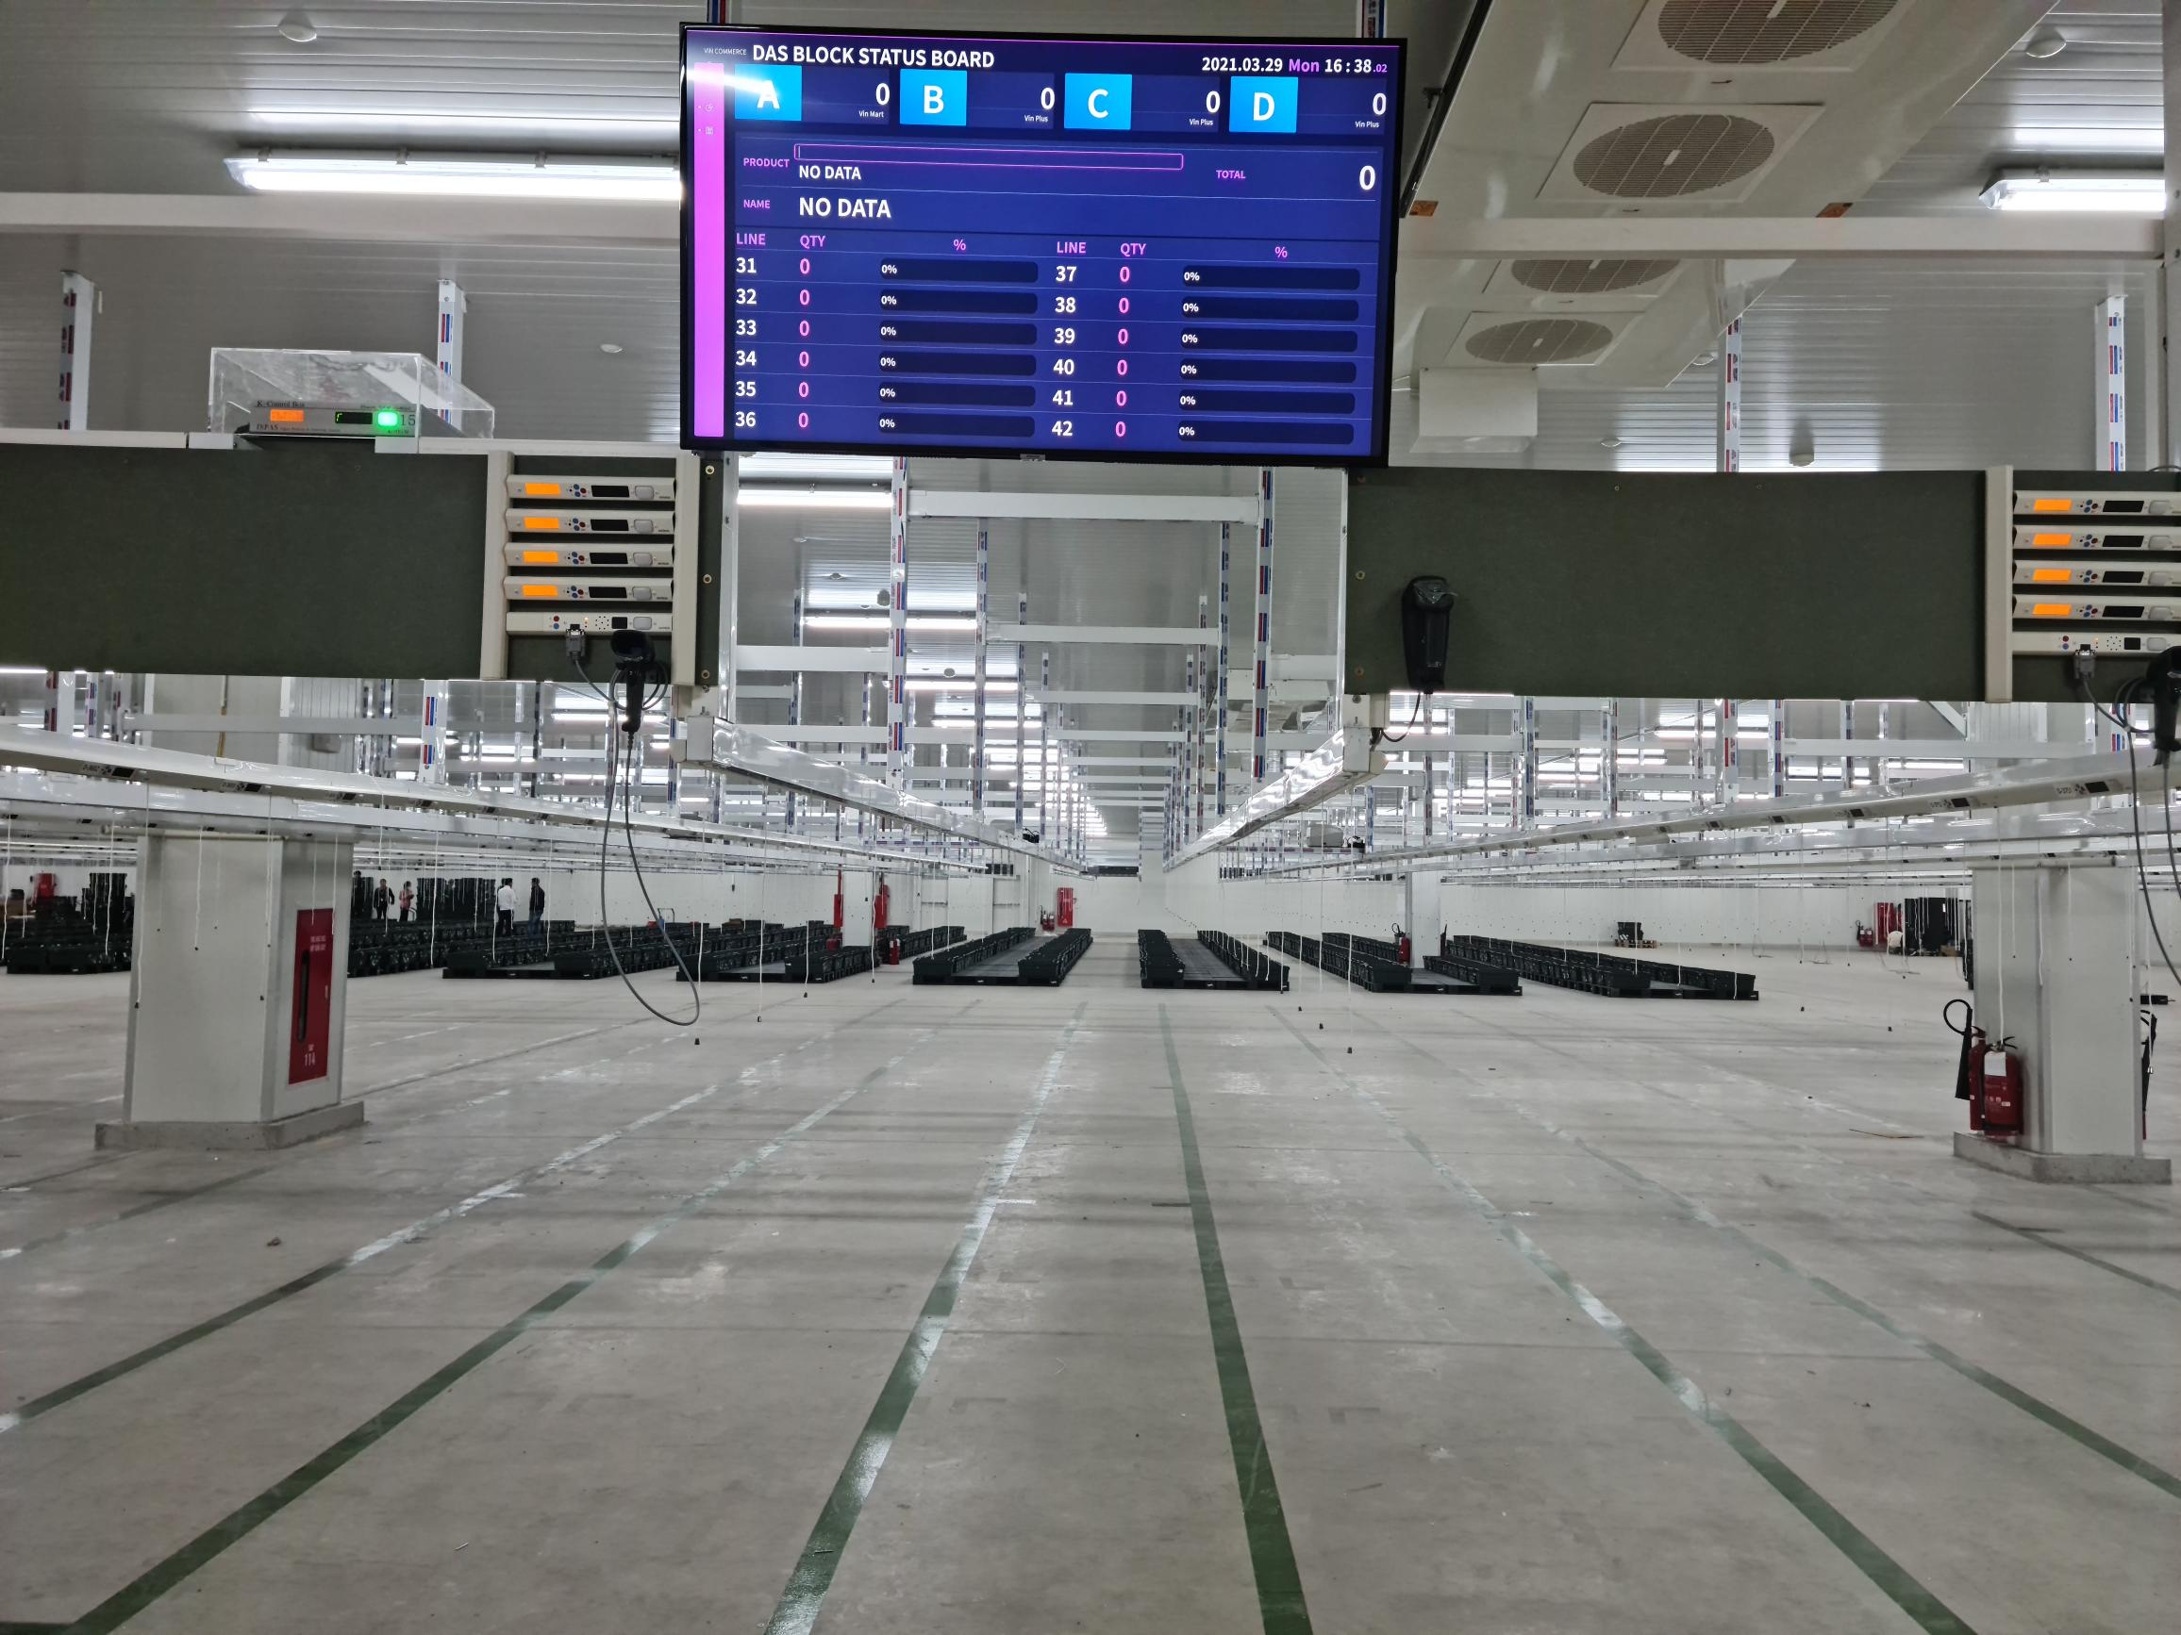
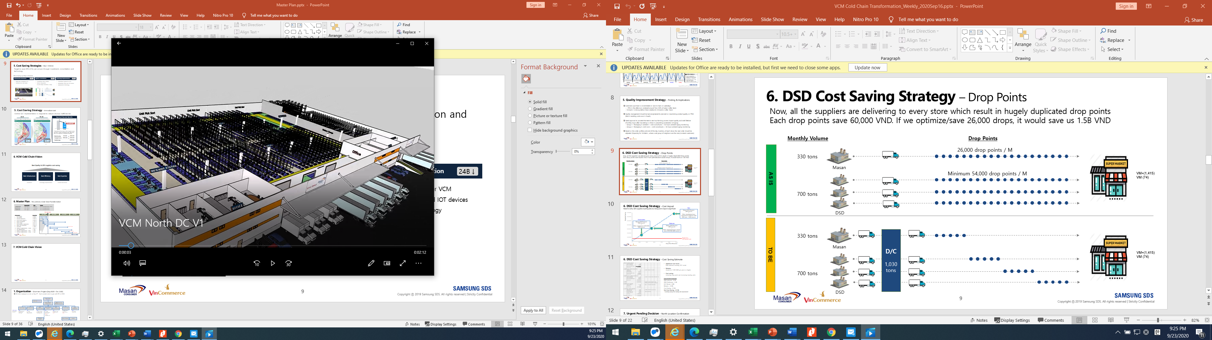
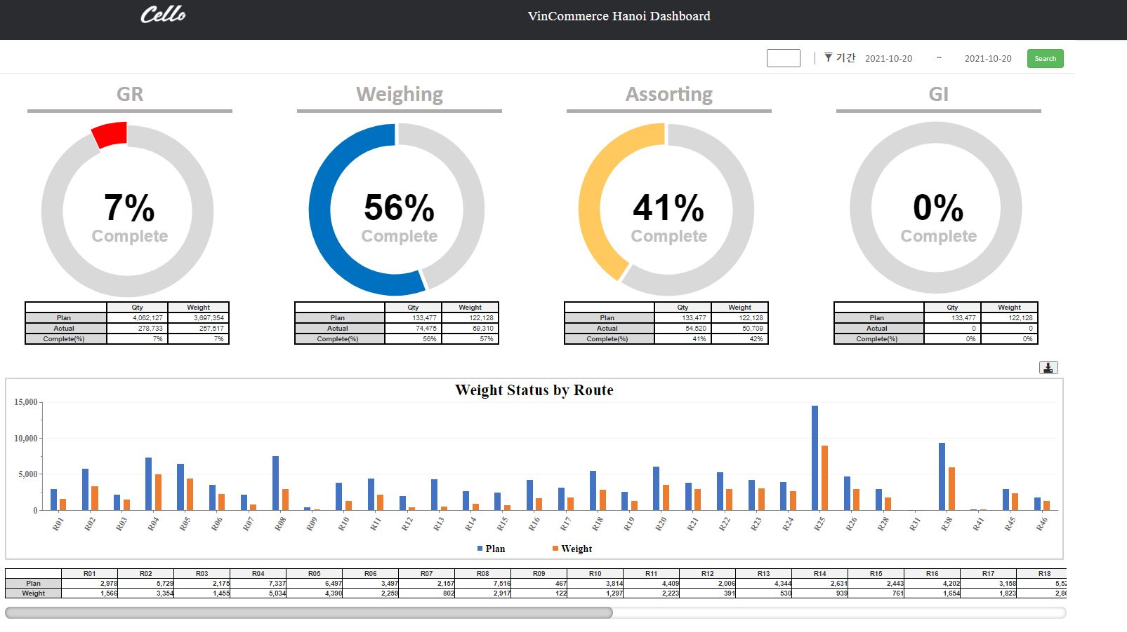
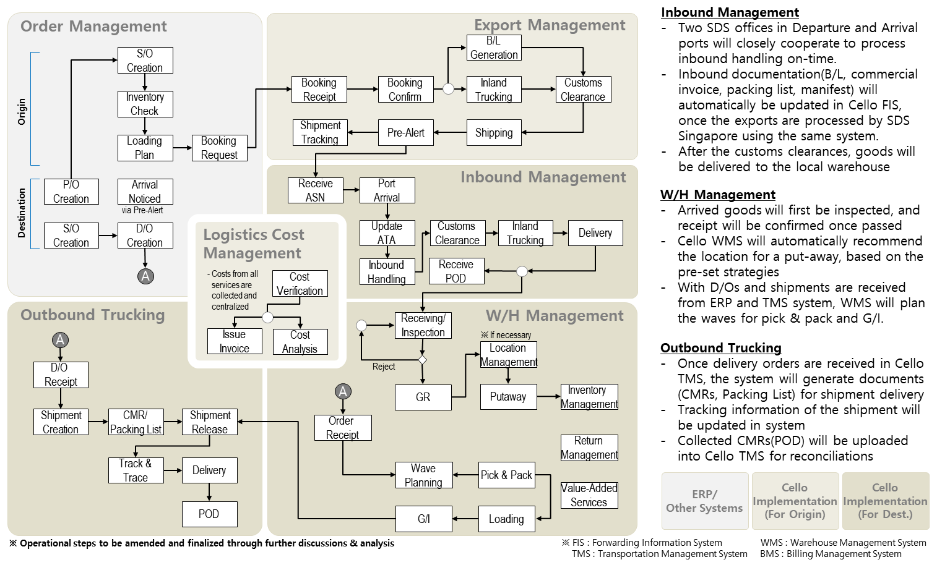
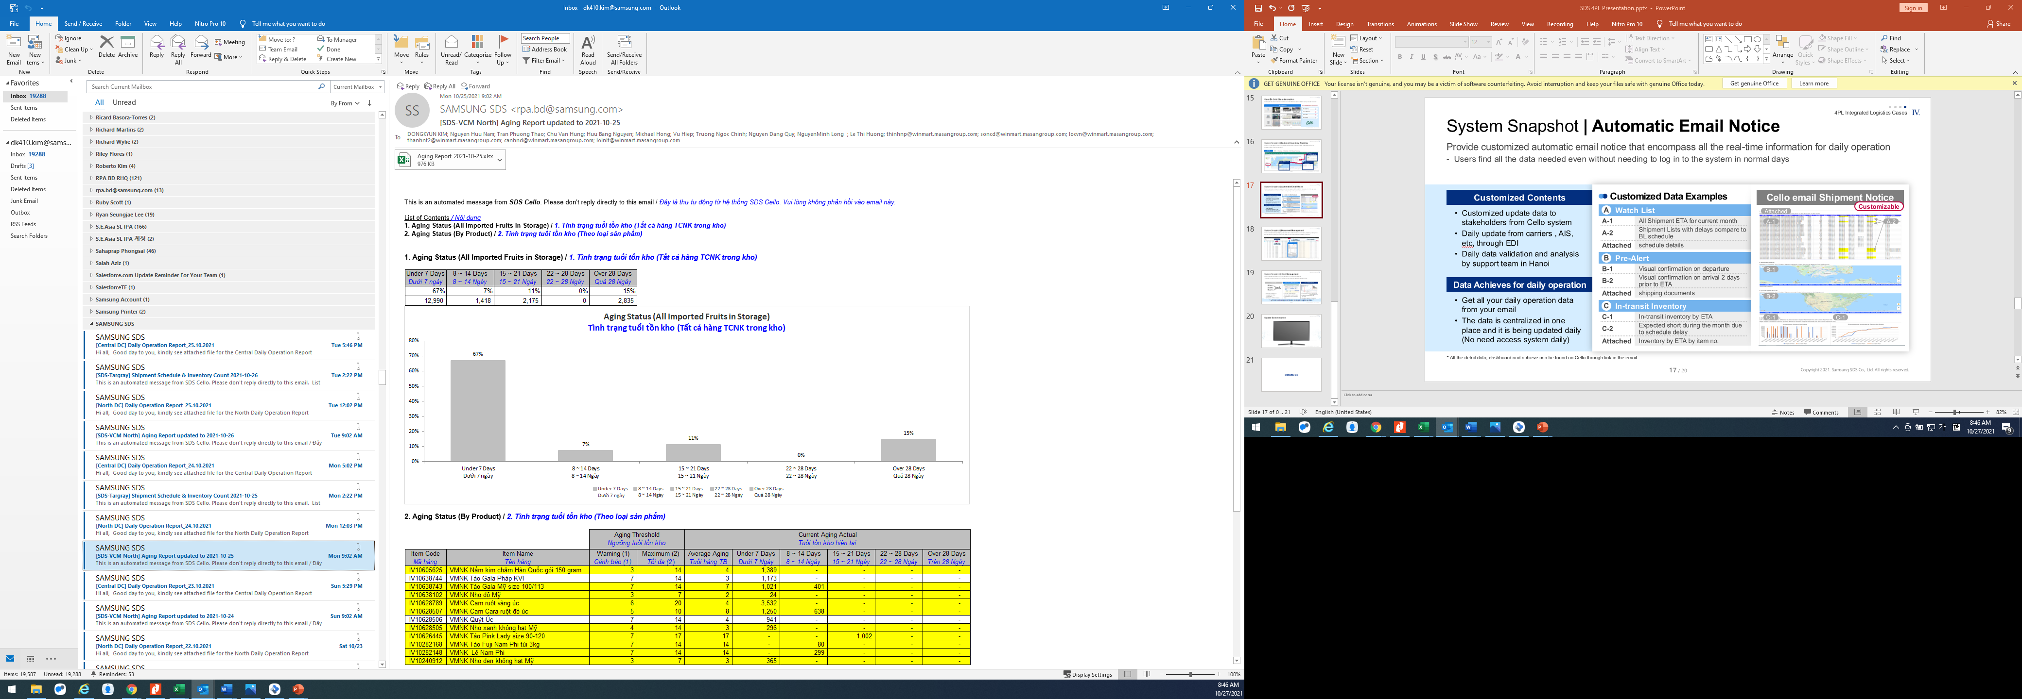
4PL Integrated Logistics
III.
[4PL Integrated Logistics Case] Innovation Tasks
Implemented 6 major tasks for execution which are required to improve customer’s business competitiveness.
Network Optimization
Identified ideal location for DC to minimize trip distance to over 3,000 delivery destinations nation wide
1
Digital Assorting System
Identified and installed optimum equipment through cost simulation that maximize ROI given local labor costs
4
DC Design
Optimized moving paths and space allocation for handling all of the fresh SKUs of the customer
System Customization
Created dashboard to eliminate or minimize job bottleneck between processes focusing on key part of the customers’ operation processes
2
5
SOP & System Design
Redesigned DC cross-doc process to maximize efficiency and customize the system functions to best support the business
RPA
Send RPA automated email alert to provide key inventory and cost related data directly to major stakeholders at logistics, planning, and finance
3
6

Slide 24
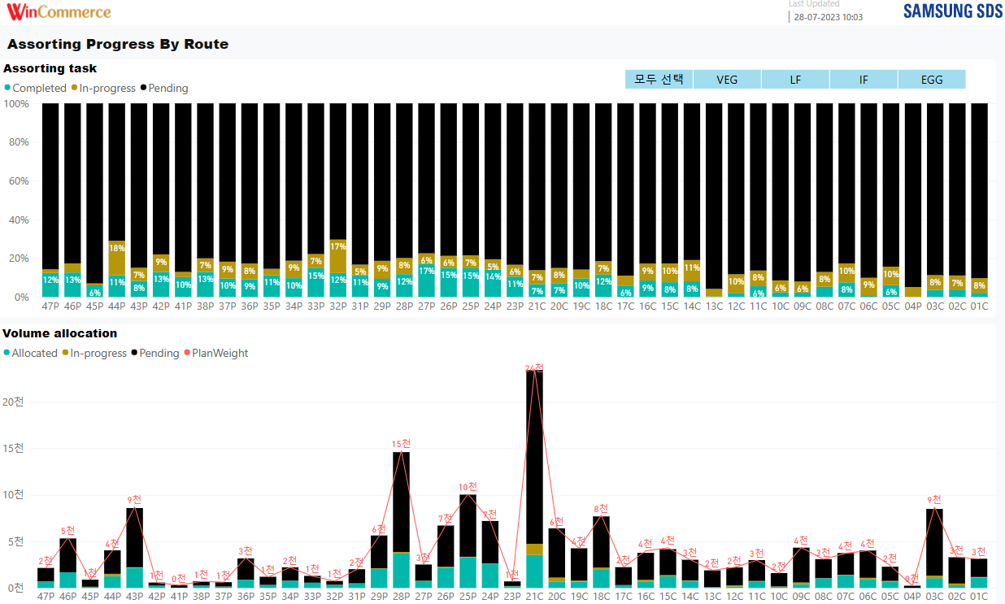
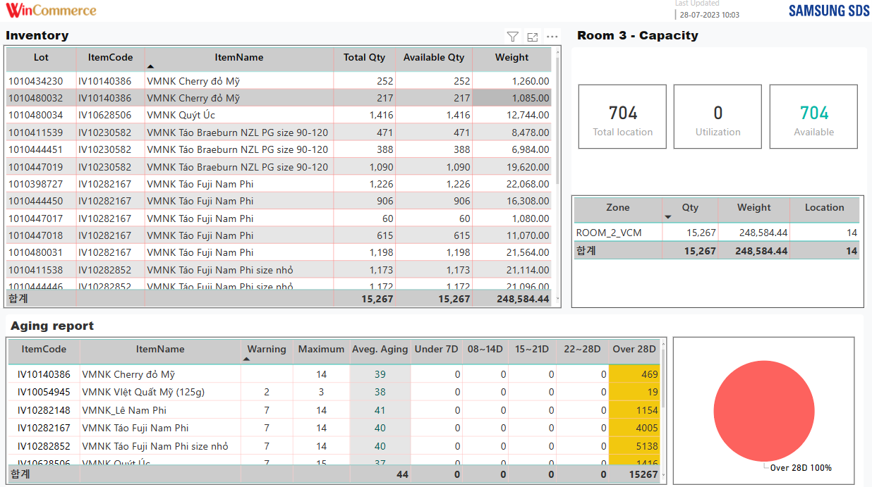
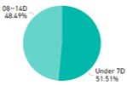
4PL Integrated Logistics
III.
[4PL Integrated Logistics Case] System Customization
A total of 15 customized reports were provided, and the basis for efficiency enhancement was laid by securing visibility for each stage of operation.
Case 1: Productivity Improvement
Case 2: Aging Minimization
Sorting progress status by delivery routes and volume display
→ Instant fix based on real-time overview
Item-level inventory information and excessive Aging status update
→ Alert by dashboard/RPA daily report

Slide 25
4PL Integrated Logistics
III.
[4PL Integrated Logistics Case] Implementation Result
Monitoring Item-level Aging status and Warning message(Automatic e-Mail) to Purchase, Planning, Logistics, Management → Shrinkage and quality issue reduced by 50% in 4 weeks
Warehouse Operation Productivity Improvement
Maximization of Aging Inventory
Reduction
DC Labor Productivity
Daily handling volume in KG per person per hour
Aging Status
Storage volume share by aging status since implementation of RPA
Normal Inventory
(in ideal freshness)
55
Aging Inventory
(Non-ideal freshness)
Excessive Aging
(Shrinkage Risk)
Conventional DC

Slide 26
4PL Integrated Logistics
III.
[4PL Integrated Logistics Case] Implementation Result
With the Cold Chain supply chain 4PL integrated logistics innovation, we created customer’s Business competitiveness and Entry Barrier to competitors.
Samsung SDS Initiatives
Customer Value Creation
Built the best D/C Infra in Vietnam
(End-to-end temperature control)
Nationwide
3,000 Stores
Product Quality
Innovation
Logistics Cost
& Shrinkage
Optimization
Infrastructure
Constant innovation of operation efficiency
(Productivity, Speed)
Maximize product freshness through platform based operation
Lowest cost structure to build entry barrier for competition
Operation
Implemented customized system
Optimization module/ RPA
“ Create Business Competitiveness
and Entry Barrier for Competitors ”
Technology

Slide 27
IV
Suggestion

Slide 28
Suggestion
IV.
Suggestion
Supply chain innovation is very important to create a sustainable growth model. In order to achieve this, SDS will successfully provide digitalization-based logistics innovation by deploying self-developed system, logistics capabilities, experience and experts.
Core Model for Sustainable Growth :
Standardization → Digitalization → Scale → Innovation (Virtuous Circle)
This is an opportunity to achieve the goal while reducing trial and error and avoiding CAPEX investment by carrying out 4PL logistics innovation with Samsung SDS.
Secure Additional Competitiveness and Achieve Vision with Logistics Innovation → “Great services, great qualities and on-time delivery”
* Source: jskor.com/en/company

Slide 29
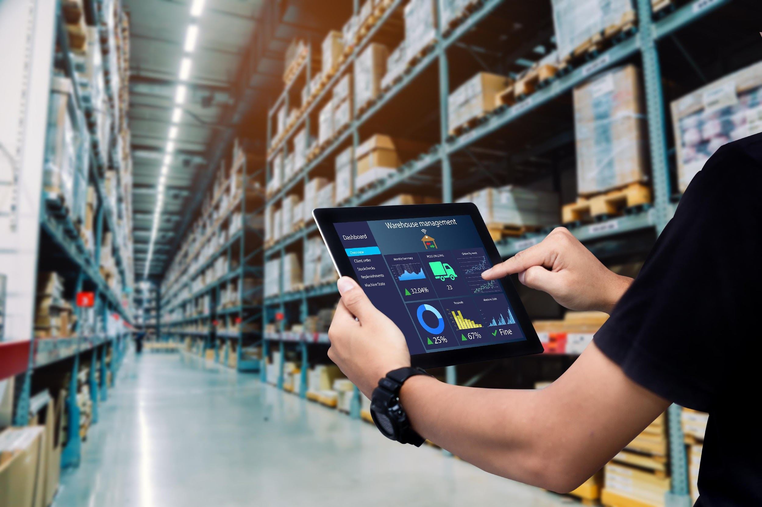

Notes:
앞에서는 우용호 상무께서 supply chain의 digitalization의 Trend에 대해서 설명드렸습니다.
이번 세션에서는 SDS의 두가지 솔루션에 대해서 시스템 데모와 함께 어떻게 실제 업무에 적용될수 있는지에 대해서 설명을 드리도록 하겠습니다.

